Slide 1
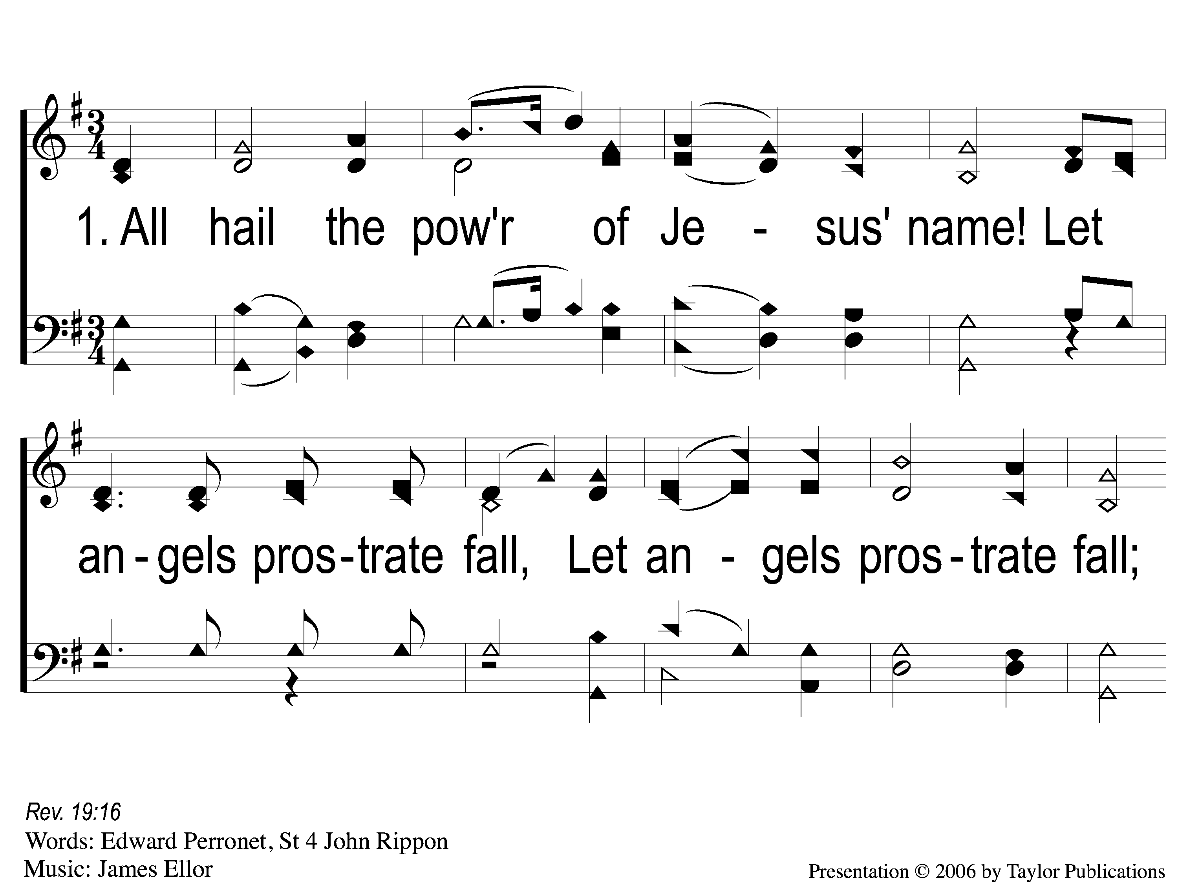
1-1 All Hail the Power of Jesus/ Name
All Hail the Power of Jesus’ Name
304

Slide 2
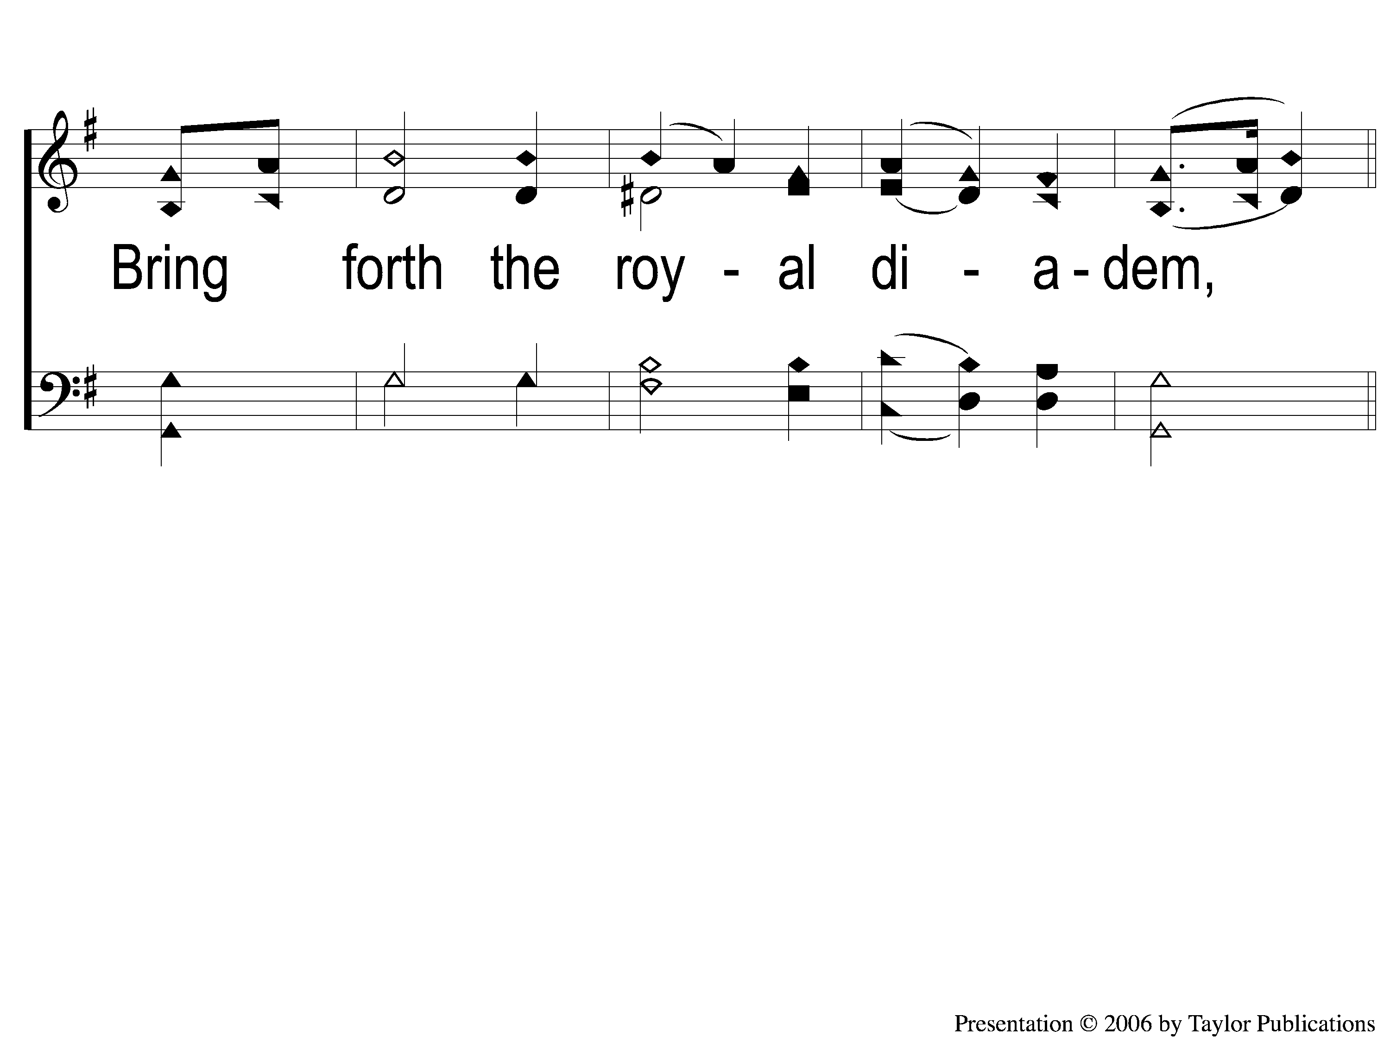
1-2 All Hail the Power of Jesus/ Name
All Hail the Power of Jesus’ Name
304

Slide 3
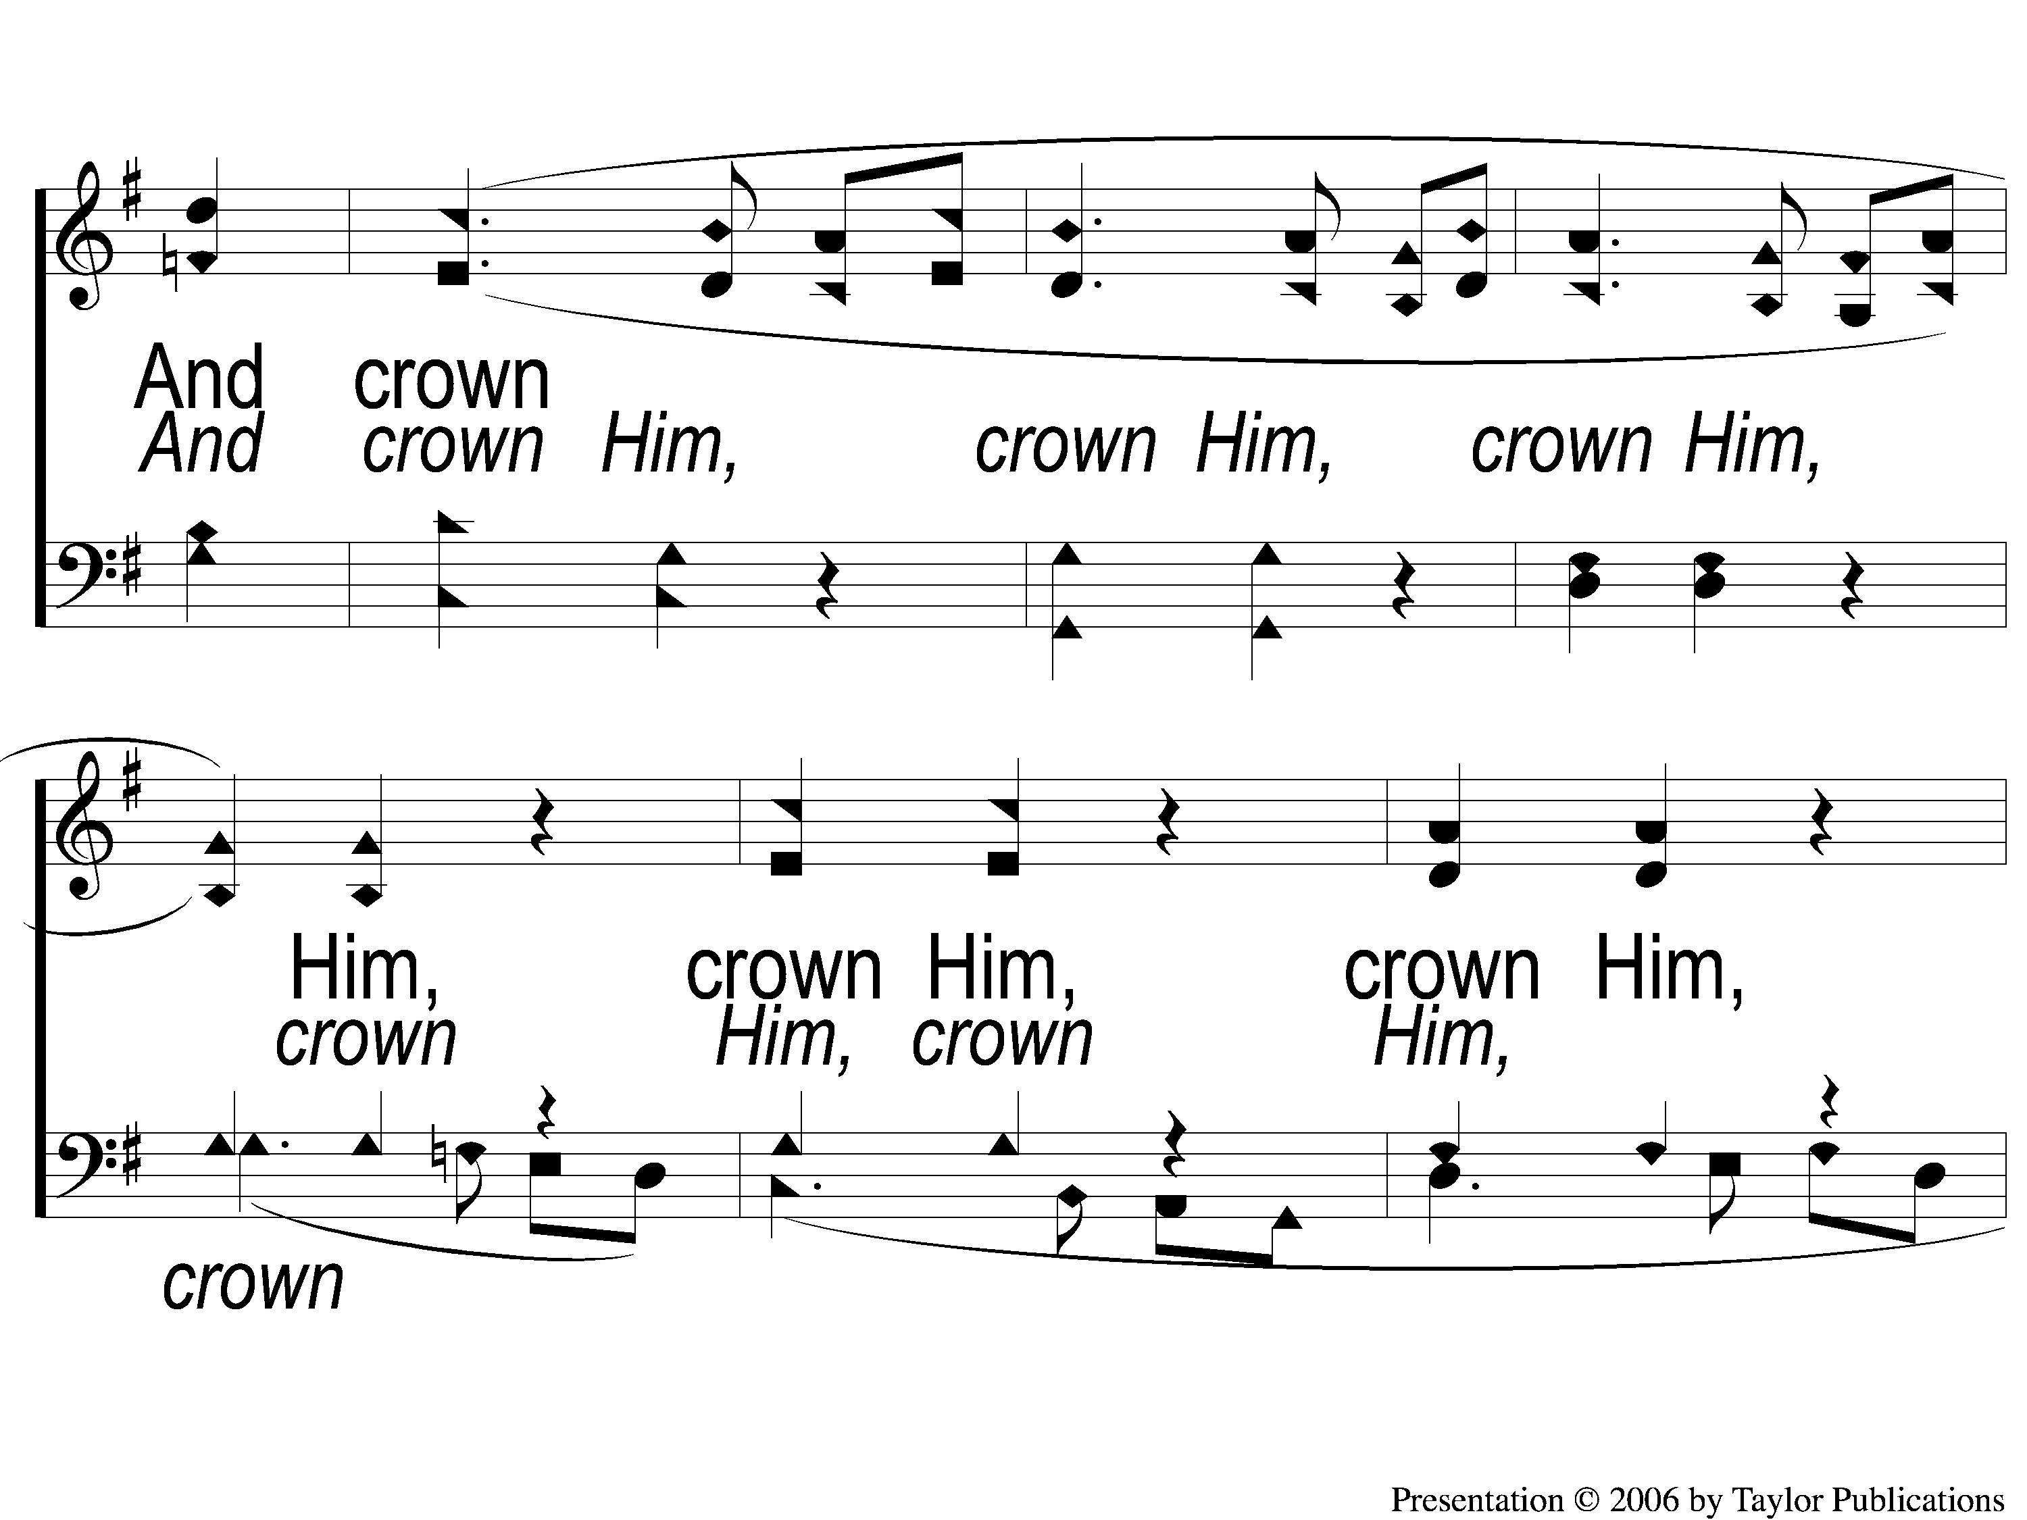
C-1 All Hail the Power of Jesus/ Name
All Hail the Power of Jesus’ Name
304

Slide 4
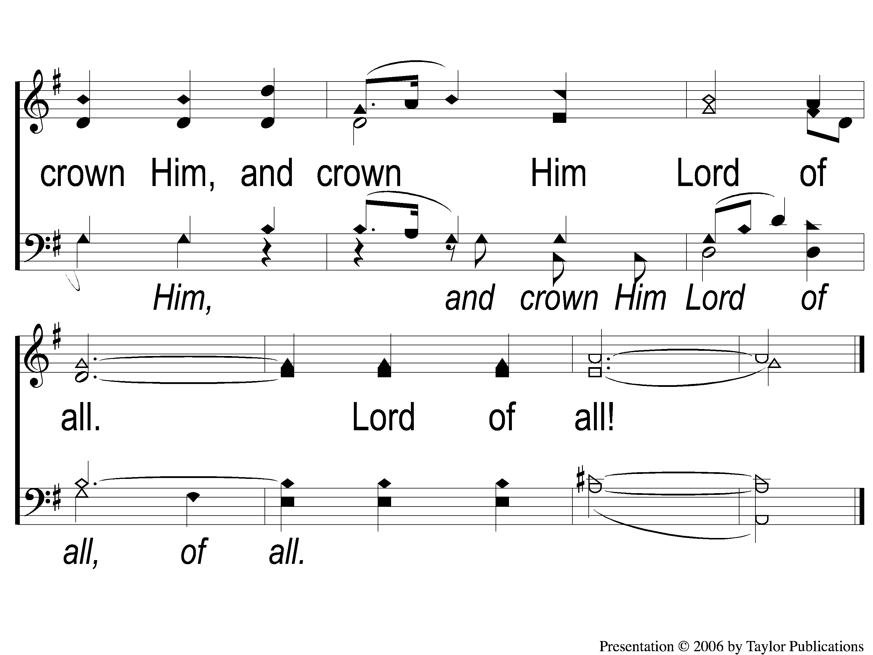
C-2 All Hail the Power of Jesus/ Name
All Hail the Power of Jesus’ Name
304

